Slide 1

SIL Stacking Models Performance
Presented by:
Data Science
January 2025

Slide 2
For Android Users: CatBoost Stacking with and without Product Type Feature (FSPD30)
Beta 2 stacking – Android (Catboost) | 01/07/2023 - 30/06/2024 |  | 01/07/2024 - 31/07/2024 | 01/08/2024 - 31/07/2024 | 01/09/2024- 30/09/2024 | 01/10/2024- 25/10/2024
 | Train Gini (90%) | Val Gini (10%) | July Gini | Aug Gini | Sep Gini | Oct Gini
Demo -Current 17 feat Model (Catboost) – v2 | 0.3392 | 0.2627 | 0.2663 | 0.2554 | 0.2643 | 0.2691
Demo + Credo | 0.4288 | 0.4183 | 0.3431 | 0.3361 | 0.3498 | 0.3566
Demo + Apps | 0.4844 | 0.4961 | 0.3498 | 0.3321 | 0.3519 | 0.3590
Demo + Apps + Credo | 0.4974 | 0.4962 | 0.3611 | 0.3476 | 0.3671 | 0.3738
Demo + Credo + CIC | 0.4562 | 0.4336 | 0.3652 | 0.3627 | 0.3802 | 0.3941
Demo + Apps + CIC | 0.5026 | 0.5048 | 0.3711 | 0.3582 | 0.3796 | 0.3868
Demo + Apps + Credo + CIC | 0.5137 | 0.5048 | 0.3806 | 0.3697 | 0.3917 | 0.4020
Beta2 Stack
Alpha Stack
With Product Type Feature
Without Product Type Feature
Beta 2 stacking – Android (Catboost) | 01/07/2023 - 30/06/2024 |  | 01/07/2024 - 31/07/2024 | 01/08/2024 - 31/07/2024 | 01/09/2024- 30/09/2024 | 01/10/2024- 25/10/2024
 | Train Gini (90%) | Val Gini (10%) | July Gini | Aug Gini | Sep Gini | Oct Gini
Demo -Current 17 feat Model (Catboost) – v2 | 0.3392 | 0.2627 | 0.2663 | 0.2554 | 0.2643 | 0.2691
Demo + Credo | 0.4347 | 0.4215 | 0.3659 | 0.3504 | 0.3641 | 0.3807
Demo + Apps | 0.4853 | 0.4949 | 0.3570 | 0.3368 | 0.3618 | 0.3497
Demo + Apps + Credo | 0.4994 | 0.4956 | 0.3687 | 0.3511 | 0.3750 | 0.3718
Demo + Credo + CIC | 0.4597 | 0.4358 | 0.3819 | 0.3716 | 0.3927 | 0.4090
Demo + Apps + CIC | 0.5044 | 0.5043 | 0.3751 | 0.3608 | 0.3858 | 0.3870
Demo + Apps + Credo + CIC | 0.5135 | 0.5047 | 0.3872 | 0.3731 | 0.3972 | 0.4057
Beta2 Stack
Alpha Stack

Slide 3
For iOS Users: CatBoost Stacking with and without Product Type Feature (FSPD30)
Beta 2 stacking – ios (catboost) | 01/07/2023 - 30/06/2024 |  | 01/07/2024 - 31/07/2024 | 01/08/2024 - 31/07/2024 | 01/09/2024- 30/09/2024 | 01/10/2024- 25/10/2024
 | Train Gini (90%) | Val Gini (10%) | July Gini | Aug Gini | Sep Gini | Oct Gini
Demo -Current 17 feat Model (Catboost) – v2 | 0.3392 | 0.2627 | 0.2663 | 0.2554 | 0.2643 | 0.2691
Demo + Credo | 0.4235 | 0.3634 | 0.1977 | 0.2773 | 0.3521 | 0.2601
Demo + CIC | 0.4033 | 0.3977 | 0.3133 | 0.2869 | 0.3573 | 0.3024
Demo + Credo + CIC | 0.4663 | 0.3966 | 0.2709 | 0.2963 | 0.3583 | 0.3334
Beta2 Stack
Alpha Stack
Without Product Type Feature
With Product Type Feature
Beta 2 stacking – ios (catboost) | 01/07/2023 - 30/06/2024 |  | 01/07/2024 - 31/07/2024 | 01/08/2024 - 31/07/2024 | 01/09/2024- 30/09/2024 | 01/10/2024- 25/10/2024
 | Train Gini (90%) | Val Gini (10%) | July Gini | Aug Gini | Sep Gini | Oct Gini
Demo -Current 17 feat Model (Catboost) – v2 | 0.3392 | 0.2627 | 0.2663 | 0.2554 | 0.2643 | 0.2691
Demo + Credo | 0.4185 | 0.3588 | 0.2654 | 0.2476 | 0.3795 | 0.3173
Demo + CIC | 0.4180 | 0.3849 | 0.2780 | 0.2371 | 0.3672 | 0.3101
Demo + Credo + CIC | 0.4702 | 0.3941 | 0.3046 | 0.2766 | 0.3812 | 0.3292
Beta2 Stack
Alpha Stack

Slide 4
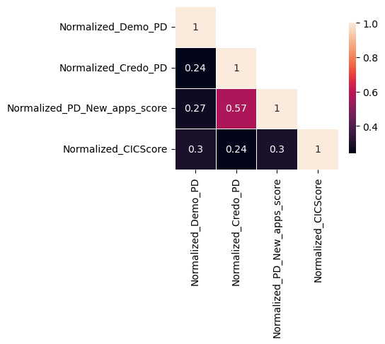
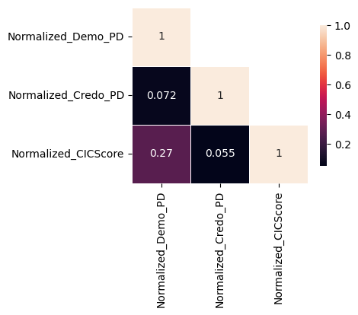
Android
IOS

Slide 5
APPENDIX 1 : Back-up Slides

Slide 6
For Android Users: Stacking by Catboost works better
Beta 2 stacking – Android (Catboost) | 01/07/2023 - 30/06/2024 |  | 01/07/2024 - 31/07/2024 | 01/08/2024 - 31/07/2024 | 01/09/2024- 30/09/2024 | 01/10/2024- 25/10/2024
 | Train Gini (90%) | Val Gini (10%) | July Gini | Aug Gini | Sep Gini | Oct Gini
Demo -Current 17 feat Model (Catboost) – v2 | 0.3392 | 0.2627 | 0.2663 | 0.2554 | 0.2643 | 0.2691
Demo + Credo | 0.4288 | 0.4183 | 0.3431 | 0.3361 | 0.3498 | 0.3566
Demo + Apps | 0.4844 | 0.4961 | 0.3498 | 0.3321 | 0.3519 | 0.3590
Demo + Apps + Credo | 0.4974 | 0.4962 | 0.3611 | 0.3476 | 0.3671 | 0.3738
Demo + Credo + CIC | 0.4562 | 0.4336 | 0.3652 | 0.3627 | 0.3802 | 0.3941
Demo + Apps + CIC | 0.5026 | 0.5048 | 0.3711 | 0.3582 | 0.3796 | 0.3868
Demo + Apps + Credo + CIC | 0.5137 | 0.5048 | 0.3806 | 0.3697 | 0.3917 | 0.4020
Beta2 Stack
Alpha Stack
Beta 2 stacking – Android (Simple Average) | 01/07/2023 - 30/06/2024 |  | 01/07/2024 - 31/07/2024 | 01/08/2024 - 31/07/2024 | 01/09/2024- 30/09/2024 | 01/10/2024- 25/10/2024
 | Train Gini (90%) | Val Gini (10%) | July Gini | Aug Gini | Sep Gini | Oct Gini
Demo -Current 17 feat Model (Catboost) – v2 | 0.3392 | 0.2627 | 0.2663 | 0.2554 | 0.2643 | 0.2691
Demo + Credo | 0.4180 | 0.4147 | 0.3410 | 0.3346 | 0.3467 | 0.3568
Demo + Apps | 0.4491 | 0.4682 | 0.3492 | 0.3328 | 0.3492 | 0.3304
Demo + Apps + Credo | 0.4589 | 0.4731 | 0.3635 | 0.3555 | 0.3736 | 0.3560
Demo + Credo + CIC | 0.4322 | 0.4211 | 0.3549 | 0.3545 | 0.3693 | 0.3834
Demo + Apps + CIC | 0.4122 | 0.4193 | 0.3257 | 0.3231 | 0.3374 | 0.3150
Demo + Apps + Credo + CIC | 0.4527 | 0.4580 | 0.3626 | 0.3614 | 0.3776 | 0.3625

Slide 7
For iOS Users: Stacking by Catboost works better
Beta 2 stacking – ios (catboost) | 01/07/2023 - 30/06/2024 |  | 01/07/2024 - 31/07/2024 | 01/08/2024 - 31/07/2024 | 01/09/2024- 30/09/2024 | 01/10/2024- 25/10/2024
 | Train Gini (90%) | Val Gini (10%) | July Gini | Aug Gini | Sep Gini | Oct Gini
Demo -Current 17 feat Model (Catboost) – v2 | 0.3392 | 0.2627 | 0.2663 | 0.2554 | 0.2643 | 0.2691
Demo + Credo | 0.4235 | 0.3634 | 0.1977 | 0.2773 | 0.3521 | 0.2601
Demo + CIC | 0.4033 | 0.3977 | 0.3133 | 0.2869 | 0.3573 | 0.3024
Demo + Credo + CIC | 0.4663 | 0.3966 | 0.2709 | 0.2963 | 0.3583 | 0.3334
Beta2 Stack
Alpha Stack
Beta 2 stacking – ios (Simple Average) | 01/07/2023 - 30/06/2024 |  | 01/07/2024 - 31/07/2024 | 01/08/2024 - 31/07/2024 | 01/09/2024- 30/09/2024 | 01/10/2024- 25/10/2024
 | Train Gini (90%) | Val Gini (10%) | July Gini | Aug Gini | Sep Gini | Oct Gini
Demo -Current 17 feat Model (Catboost) – v2 | 0.3392 | 0.2627 | 0.2663 | 0.2554 | 0.2643 | 0.2691
Demo + Credo | 0.3444 | 0.3534 | 0.1533 | 0.2285 | 0.3318 | 0.2469
Demo + CIC | 0.3422 | 0.3417 | 0.2728 | 0.2741 | 0.3562 | 0.2723
Demo + Credo + CIC | 0.3555 | 0.3462 | 0.2204 | 0.2331 | 0.3577 | 0.2808

